Slide 1
UNIT 4
80386 & 80486 MICROPROCESSORS

Slide 2
Silent Features of 80386DX
It is a 32-bit microprocessor.
It supports 8-bit/16-bit/32-bit data operands.
80386 instruction set is upward compatible with all its predecessors.
It means 80386 can run 8086 application programs under protected mode in its virtual 8086 mode of operation.
It has 32 address lines A31 to A0. By using these lines it can able to address maximum of memory is 4GB (2³² = 4GB).

Slide 3
The physical memory is organized in terms of segments of 4GB size at maximum. The 80386 supports 16K number of segments and thus total virtual memory space is 4GBX16 = 64TB.
The memory management section of the processor supports the virtual memory, paging and four levels of protection.
This processor has mathematical coprocessor 80387.
It has eight debug registers DR0 to DR7 for hardware debugging and control.

Slide 4
This processor has onboard address translation cache
80386 has another version 80386SX. Only the difference is it has 16 data lines and 24 address lines.
This 80386DX is available in 132-pin grid array (PGA) package and has operating frequencies 20MHz and 33MHz.

Slide 5
Architecture of 80386
Internal Architecture of 80386 is divided into 3 sections.
1. Central processing unit
2. Memory management unit
3. Bus interface unit

Slide 6
EU
EU
AU
8085
BIU
IU
BIU
8086
80286
EU
AU
IU
BIU
80386

Slide 7
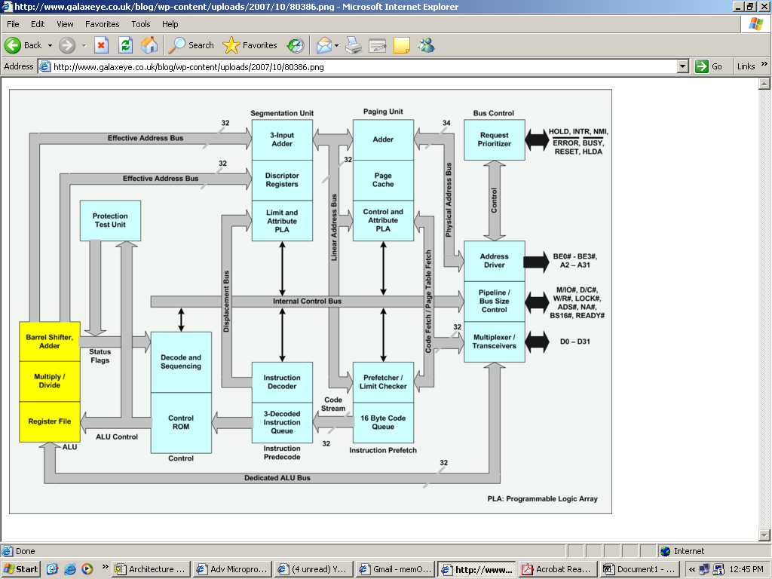

Slide 8
1. Central processing unit
It is further divided into two parts. Those are
1.Execution unit
2.Instruction unit.
Execution unit
It has 8 General purpose and 8 Special purpose registers which are either used for handling data or calculating offset addresses.
Instruction unit
This unit decodes the op code bytes received from the 16-byte instruction code queue and arranges them in a 3- instruction decoded instruction queue.

Slide 9
2.Memory management unit
It consists of a Segmentation unit and a Paging unit.
Segmentation unit
It allows the use of two address components, viz. segment and offset for relocability and sharing of code and data.
Segmentation unit allows segment of size 4Gbytes at maximum.
Paging unit
It organizes the physical memory in terms of pages of 4kbytes size each.
Paging unit works under the control of the segmentation unit.
3.Bus control unit
It has a prioritizer to resolve the priority of the various bus requests.
This controls the access of the bus.
The address driver drives the bus enable and address signals A31 – A0.

Slide 10
Signal Descriptions of 80386:
It consists of 132 pins or signals or lines.

Slide 11
Register Organization
General purpose registers:
The 80386 has eight 32 - bit general purpose registers which may be used as either 8 bit or 16 bit registers.
A 32 - bit register known as an extended register, is represented by the register name with prefix E.
Example: - A 32 bit register corresponding to AX is EAX, similarly BX is EBX etc.
So the general purpose registers of 80386 are
EAX,EBX,ECX,EDX,EBP,ESP,ESI and EDI.
BP, SP, SI, DI represents the lower 16 bit of their 32 bit counterparts, and can be used as independent 16 bit registers.
A 16 bit flag register is available along with 32 bit counter part EFLAGS.

Slide 12
Segment registers :
The six segment registers available in 80386 are CS, SS, DS, ES, FS and GS.
The CS and SS are the code and the stack segment registers respectively, while DS, ES, FS, GS are 4 data segment registers.
A 16 bit instruction pointer IP is available along with 32 bit counterpart EIP.

Slide 14
Flag register :

Slide 15
Flag Register…………..
The Flag register of 80386 is a 32-bit register.
Out of the 32 bits, Intel has reserved bits D18 to D31, D5 and D3, while D1 is always set at 1.
Two extra new flags are added to the 80286 flag to derive the flag register of 80386.
They are VM and RF flags.

Slide 16
VM - Virtual Mode Flag :
If this flag is set, the 80386 enters the virtual 8086 mode within the protection mode.
This is to be set only when the 80386 is in protected mode. In this mode, if any privileged instruction is executed an exception 13 is generated.
This bit can be set using IRET instruction or any task switch operation only in the protected mode.

Slide 17
RF- Resume Flag :
This flag is used with the debug register breakpoints.
It is checked at the starting of every instruction cycle and if it is set, any debug fault is ignored during the instruction cycle.
The RF is automatically reset after successful execution of every instruction, except for IRET and POPF instructions.

Slide 18
Segment Descriptor Registers :
This registers are not available for programmers, rather they are internally used to store the descriptor information, like attributes, limit and base addresses of segments.
The six segment registers(CS,DS,ES,FS,GS &SS) have corresponding six 73 bit descriptor registers.
Each of them contains 32 bit base address, 32 bit base limit and 9 bit attributes.
These are automatically loaded when the corresponding segments are loaded with selectors.

Slide 19
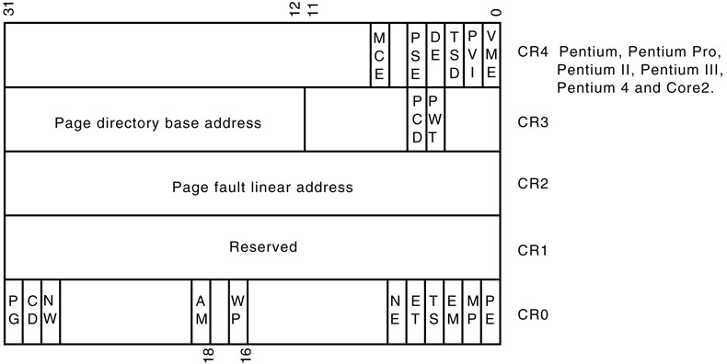
Control Registers :
The 80386 has three 32 bit control registers CR0, CR2 and CR3 to hold global machine status independent of the executed task.
Load and store instructions are available to access these registers.
Control register CR₁ is reserved for future designed processors by INTEL.
31
0

Slide 20
System Address Registers :
Four special registers are defined to refer to the descriptor tables supported by 80386.
The 80386 supports four types of descriptor table, viz.
Global Descriptor Table (GDT),
Interrupt Descriptor Table (IDT),
Local Descriptor Table (LDT)
Task State Segment Descriptor Table (TSSDT).

Slide 21
Debug Registers :
Intel has provided a set of 8 debug registers for hardware debugging.
Out of these eight registers DR0 to DR7, two registers DR4 and DR5 are Intel reserved.
The initial four registers DR0 to DR3 store four program controllable breakpoint addresses, while DR6 and DR7 respectively hold breakpoint status and breakpoint control information.

Slide 22
breakpoint control info
DR7
breakpoint status
DR6
RESERVED
DR5
RESERVED
DR4
Linear breakpoint address 3
DR3
Linear breakpoint address 2
DR2
Linear breakpoint address 1
DR1
Linear breakpoint address 0
DR0

Slide 23
Test Registers :
Two test register are provided by 80386 for page caching namely test control and test status register.

Slide 24
Addressing Modes of 80386
The 80386 supports overall eleven addressing modes to facilitate efficient execution of higher level language programs.
In case of all those modes, the 80386 can now have 32-bit immediate or 32- bit register operands or displacements.
The 80386 has a family of scaled modes. In case of scaled modes, any of the index register values can be multiplied by a valid scale factor to obtain the displacement.

Slide 25
1. Scaled Indexed Mode: Contents of an index register are multiplied by a scale factor that may be added further to get the operand offset.
2. Based Scaled Indexed Mode: Contents of an index register are multiplied by a scale factor and then added to base register to obtain the offset.
3. Based Scaled Indexed Mode with Displacement: The Contents of an index register are multiplied by a scaling factor and the result is added to a base register and a displacement to get the offset of an operand.

Slide 26
Data Types of 80386
The 80386 supports the following 17 data types.
1. Bit – Binary digit ‘0’ or ‘1’
2. Bit Field – A group of at the most 32-bits (4Bytes)
3. Bit String – A string of continuous bits of maximum
4GB in the length
4. Signed Byte – Signed byte data
5. Unsigned Byte – Unsigned byte data
6. Integer word – Signed 16-bit data
7. Long Integer – 32-bit signed data representing with 2’s complement.
8. Unsigned Integer Word – Unsigned 16-bit data

Slide 27
9. Unsigned Long Integer – Unsigned 32-bit data
10. Signed Quad Word – A signed 64-bit data or four word data
11. Unsigned Quad Word – A unsigned 64-bit data
12. Offset – A 16 or 32-bit displacement that references a memory location using any of the addressing modes.
13. Pointer – This consists of a pair of 16-bit selector and 16/32-bit offset
14. Character – An ASCII equivalent to any of the alphanumeric or control character.
15. Strings – These are the sequence of bytes, words or double words. A string may contain minimum one byte and maximum 4GB.
16. BCD – Decimal digits from 0 to 9 represented by unpacked bytes.
17. Packed BCD – This represents two packed BCD digits using a byte.

Slide 28
Real Addressing Modes of 80386
After reset, the 80386 starts from memory location FFFFFFF0H under the real address mode.
In the real mode, 80386 works as a fast 8086 with 32-bit registers and data types.
In real mode, the default operand size is 16-bit but 32- bit operands and addressing modes may be used with the help of override prefixes.
The segment size in real mode is 64KB; hence the 32-bit effective addressing must be less than 0000FFFFFH. The real mode initializes the 80386 and prepares it for protected mode.

Slide 29
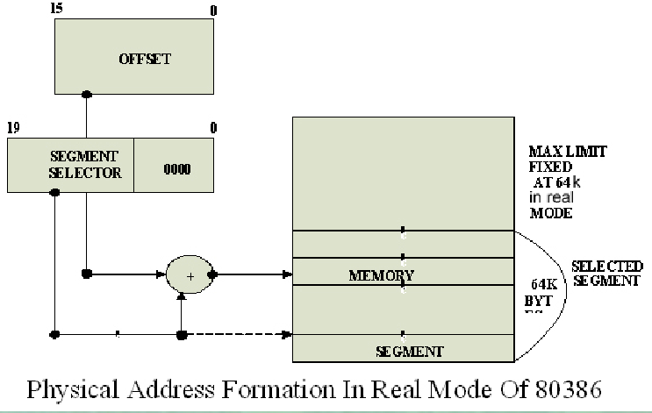
Real Addressing modes of 80386

Slide 30
Memory Addressing in Real Mode :
In the real mode, the 80386 can address at the most 1Mbytes of physical memory using address lines A0-A19.
Paging unit is disabled in real addressing mode, and hence the real addresses are the same as the physical addresses.
To form a physical memory address, appropriate segment registers contents (16-bits) are shifted left by four positions and then added to the 16-bit offset address formed using one of the addressing modes, in the same way as in the 80386 real address mode.

Slide 31
The segment in 80386 real mode can be read, write or executed, i.e. no protection is available.
Any fetch or access past the end of the segment limit generates exception 13 in real address mode.
The segments in 80386 real mode may be overlapped or non-overlapped.
The interrupt vector table of 80386 has been allocated 1Kbyte space starting from 00000H to 003FFH.

Slide 32
Protected Mode of 80386
All the capabilities of 80386 are available for utilization in its protected mode of operation.
The 80386 in protected mode support all the software written for 80286 and 8086 to be executed under the control of memory management and protection abilities of 80386.
The protected mode allows the use of additional instruction, addressing modes and capabilities of 80386.

Slide 33
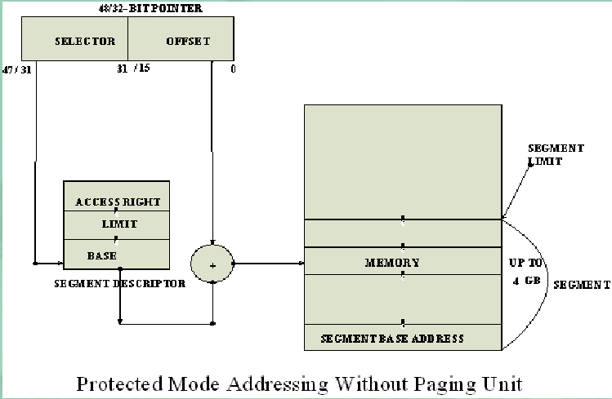

Slide 34
Addressing in Protected Mode
In this mode, the contents of segment registers are used as selectors to address descriptors which contain the segment limit, base address and access rights byte of the segment.
The effective address (offset) is added with segment base address to calculate linear address.
This linear address is further used as physical address, if the paging unit is disabled; otherwise the paging unit converts the linear address into physical address.

Slide 35
The paging unit is a memory management unit enabled only in protected mode. The paging mechanism allows handling of large segments of memory in terms of pages of 4Kbyte size.
The paging unit operates under the control of segmentation unit. The paging unit if enabled converts linear addresses into physical address, in protected mode.

Slide 36
Segmentation
Descriptor tables :
These descriptor tables and registers are manipulated by the operating system to ensure the correct operation of the processor, and hence the correct execution of the program.
Three types of the 80386 descriptor tables are listed as follows:
1. Global Descriptor Table (GDT)
2. Local Descriptor Table (LDT)
3. Interrupt Descriptor Table (IDT)

Slide 37
Descriptors :
The 80386 descriptors have a 20-bit segment limit and 32-bit segment address.
The descriptors of 80386 are 8-byte quantities access right or attribute bits along with the base and limit of the segments.
Descriptor Attribute Bits :
The A (accessed) attributed bit indicates whether the segment has been accessed by the CPU or not.
The TYPE field decides the descriptor type and hence the segment type.

Slide 38
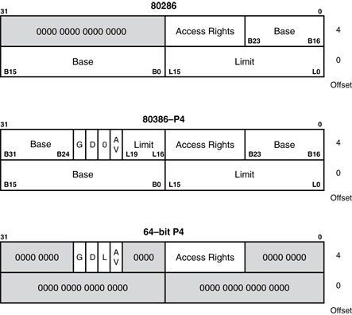
Descriptor

Slide 39
The 80386 has five types of descriptors listed as follows :
1. Code or Data Segment Descriptors.
2. System Descriptors.
3. Local descriptors.
4. TSS (Task State Segment) Descriptors.
5. GATE Descriptors.
The 80386 provides a four level protection mechanism exactly in the same way as the 80286 does.

Slide 40
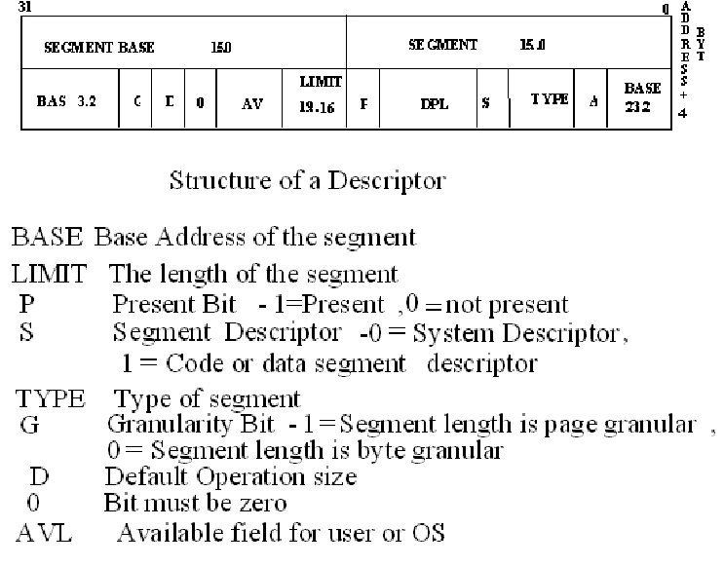

Slide 41
Paging
Paging Operation :
Paging is one of the memory management techniques used for virtual memory multitasking operating system.
The segmentation scheme may divide the physical memory into a variable size segments but the paging divides the memory into a fixed size pages.
The segments are supposed to be the logical segments of the program, but the pages do not have any logical relation with the program.

Slide 42
Paging…….
The pages are just fixed size portions of the program module or data.
The advantage of paging scheme is that the complete segment of a task need not be in the physical memory at any time.
Only a few pages of the segments, which are required currently for the execution, need to be available in the physical memory.
Thus the memory requirement of the task is substantially reduced, relinquishing the available memory for other tasks.

Slide 43
Paging…….
Whenever the other pages of task are required for execution, they may be fetched from the secondary storage.
The previous page which is executed need not be available in the memory, and hence the space occupied by them may be relinquished for other tasks.
Thus paging mechanism provides an effective technique to manage the physical memory for multitasking systems.

Slide 44
Paging Unit
The paging unit of 80386 uses a two level table mechanism to convert a linear address provided by segmentation unit into physical addresses.
The paging unit converts the complete map of a task into pages, each of size 4K.
The task is further handled in terms of its page, rather than segments.
The paging unit handles every task in terms of three components namely page directory, page tables and page itself.

Slide 45
Paging Descriptor Base Register
The control register CR2 is used to store the 32-bit linear address at which the previous page fault was detected.
The CR3 is used as page directory physical base address register, to store the physical starting address of the page directory.
The lower 12 bit of the CR3 is always zero to ensure the page size aligned directory.
A move operation to CR3 automatically loads the page table entry caches and a task switch operation, to load CR0 suitably.

Slide 46
Page Directory
This is at the most 4Kbytes in size.
Each directory entry is of 4 bytes, thus a total of 1024 entries are allowed in a directory.
The upper 10 bits of the linear address are used as an index to the corresponding page directory entry.
The page directory entries point to page tables.

Slide 47
Page Tables
Each page table is of 4Kbytes in size and many contain a maximum of 1024 entries.
The page table entries contain the starting address of the page and the statistical information about the page.
The upper 20 bit page frame address is combined with the lower 12 bit of the linear address.
The address bits A12- A21 are used to select the 1024 page table entries.
The page table can be shared between the tasks.

Slide 48
Page Tables…….
The P bit of the above entries indicates, if the entry can be used in address translation.
If P=1, the entry can be used in address translation, otherwise it cannot be used.
The P bit of the currently executed page is always high.
The accessed bit A is set by 80386 before any access to the page. If A=1, the page is accessed, else un-accessed.
The D bit (Dirty bit) is set before a write operation to the page is carried out. The D-bit is undefined for page director entries.

Slide 49
Page Tables……..
The OS reserved bits are defined by the operating system software.
The User / Supervisor (U/S) bit and read/write bit are used to provide protection.
These bits are decoded to provide protection under the 4 level protection models.
The level 0 is supposed to have the highest privilege, while the level 3 is supposed to have the least privilege.
This protection provide by the paging unit is transparent to the segmentation unit.

Slide 50
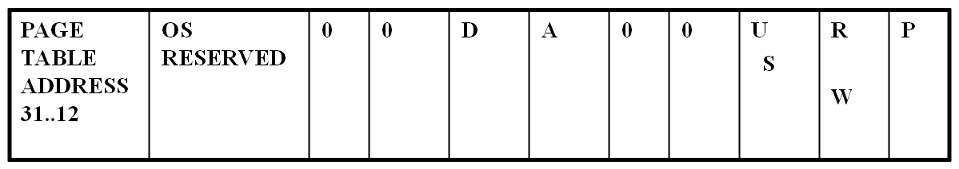
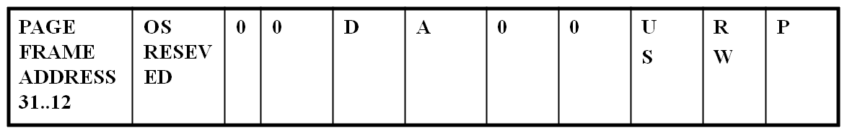
Page Directory Entry
31 12 11 10 9 8 7 6 5 4 3 2 1 0
Page Table Entry

Slide 51
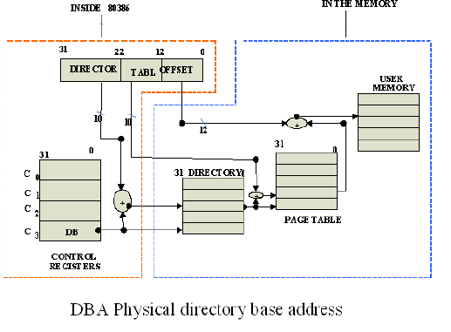

Slide 52
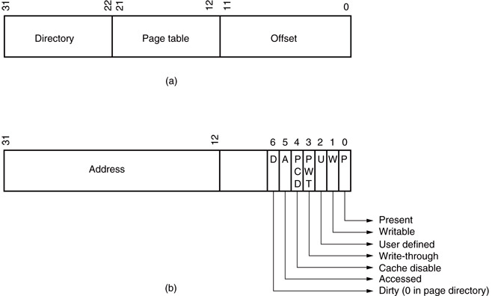
Page Directory or Page Table Entry
Higher order 20 bit of addresses of Page Table or Page. It’s implied that the lower order 12 bit is 0. This 12 bit is used to keep other info of the entry

Slide 53
Virtual mode of 8086
In its protected mode of operation, 80386DX provides a virtual 8086 operating environment to execute the 8086 programs.
The real mode can also used to execute the 8086 programs along with the capabilities of 80386, like protection and a few additional instructions.
Once the 80386 enters the protected mode from the real mode, it cannot return back to the real mode without a reset operation.
Thus, the virtual 8086 mode of operation of 80386, offers an advantage of executing 8086 programs while in protected mode.
The address forming mechanism in virtual 8086 mode is exactly identical with that of 8086 real mode.

Slide 54
Virtual mode of 8086
In virtual mode, 8086 can address 1Mbytes of physical memory that may be anywhere in the 4Gbytes address space of the protected mode of 80386.
Like 80386 real mode, the addresses in virtual 8086 mode lie within 1Mbytes of memory.
In virtual mode, the paging mechanism and protection capabilities are available at the service of the programmers.
The 80386 supports multiprogramming, hence more than one programmer may be use the CPU at a time.

